Slide 1
Time varying causal relationships between various features during the spread of COVID-19
Arunim Bhattacharya and Sachit Butail

Slide 2
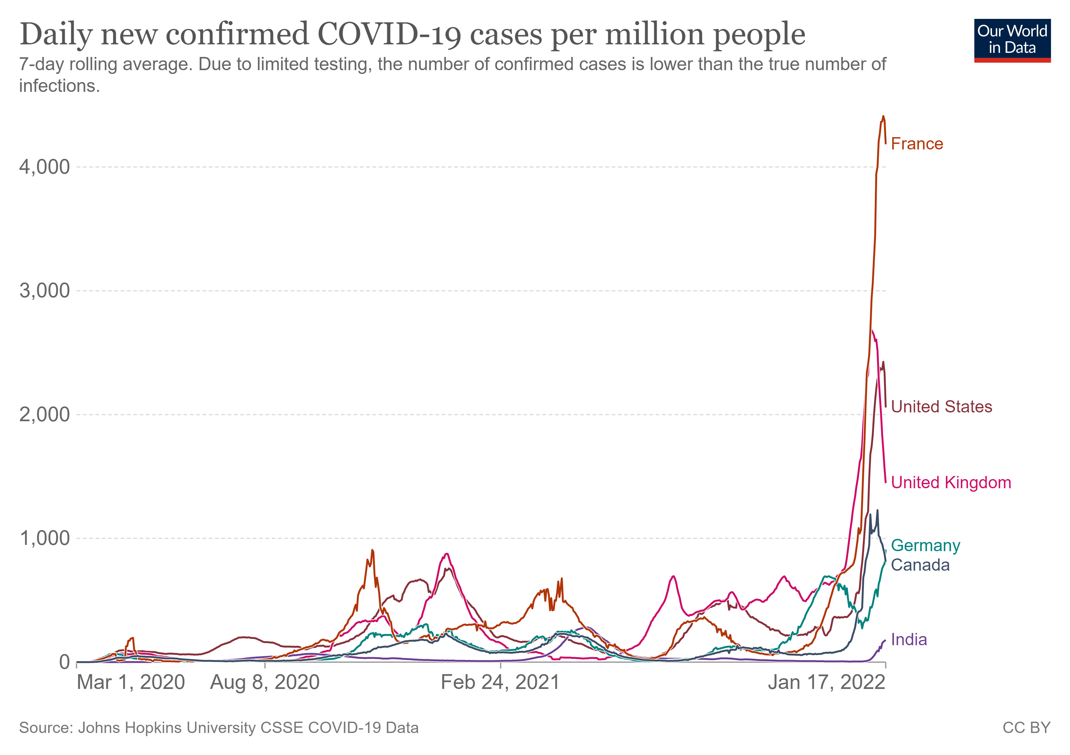
Motivation
Covid 19 is characterized by waves of infection. Possible reasons could include
Uncertain dynamic factors like mobility, mask use, vaccination rate, waning immunity etc. may play into the dynamic nature of the pandemic
At present there is enough public data available to causally link one or more of the factors to Covid pandemic dynamics.
Classic SEIR models are unable to predict these waves. Recent work has attributed this characteristic to social activity [Tkachenko et al., 2021].

Slide 3
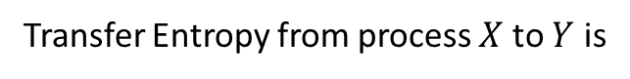
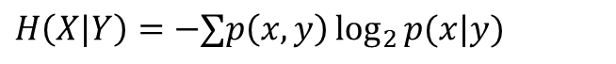
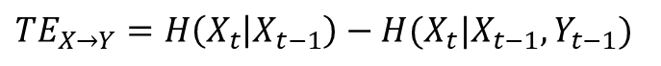
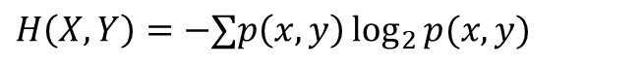
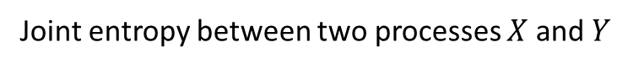
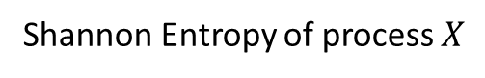
Transfer Entropy
Transfer Entropy is an information theoretic measure which quantifies the amount of information transferred between two random processes. This measure is non symmetric, thus providing a method of determining directionality of information transfer between two processes. This study assumes that the random processes are 1st order Markov chain.
Shannon Entropy of process $X$
$H\left(X\right)=−∑p\left(x\right)\log_{2}{p(x)}$, where $p\left(x\right)$ is the probability of $X$ taking the value $x$
Joint entropy between two processes $X$ and $Y$
$$H\left(X,Y\right)=−∑p\left(x,y\right)\log_{2}{p(x,y)}$$
Conditional entropy
$$H\left(X|Y\right)=−∑p\left(x,y\right)\log_{2}{p(x|y)}$$
Transfer Entropy from process $X$ to $Y$ is
$$TE_{X→Y}=H\left(X_{t} | X_{t−1}\right)−H(X_{t}|X_{t−1},Y_{t−1})$$

Slide 4
Transfer Entropy for inferring causality
Transfer Entropy (TE) will be used to determine the leading cause of infection.
To validate the approach, TE will be implemented on a coupled dynamics model, ex: Lotka Volterra and SEIR with changes
The chosen epidemic model will be modified to incorporate the dynamic factors.
A time varying causal relationship will be established by artificially modifying the dynamic factors and observing the induced change in the epidemic model output.
Next this approach will be applied to real time series data of
Infection
Death
Mobility
Testing efficacy
Mask
Other methods for inferring causality are Convergent Cross Mapping (CCM)[Sugihara et al., 2012] and using Intrinsic Mode Functions (IMF) [Yang et al., 2018]
H. Ye, E. R. Deyle, L. J. Gilarranz, and G. Sugihara, “Distinguishing time-delayed causal interactions using convergent cross mapping,” Sci Rep, vol. 5, no. 1, p. 14750, Dec. 2015, doi: 10.1038/srep14750.
A. C. Yang, C.-K. Peng, and N. E. Huang, “Causal decomposition in the mutual causation system,” Nat Commun, vol. 9, no. 1, p. 3378, Dec. 2018, doi: 10.1038/s41467-018-05845-7.

Slide 5
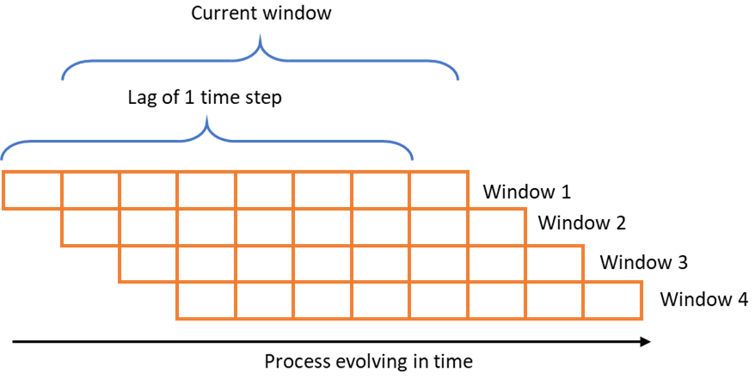
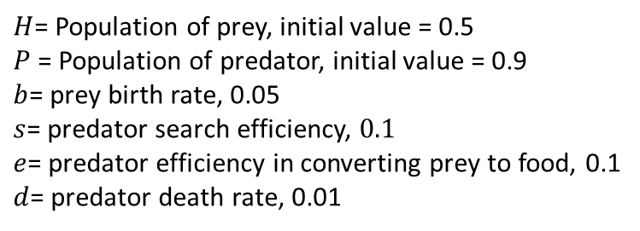
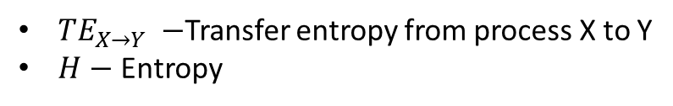
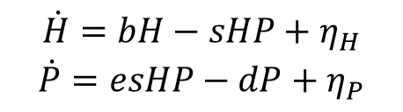
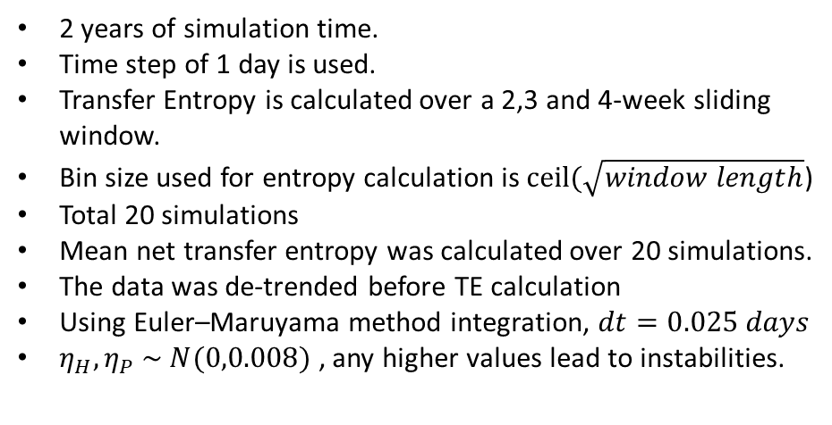
TE application to Lotka Volterra
Model
$$\dot{H}=bH−sHP+η_{H}$$
$$\dot{P}=esHP−dP+η_{P}$$
$$TE_{X→Y}=H\left(X_{t} | X_{t−1}\right)−H(X_{t}|X_{t−1},Y_{t−1})$$
$TE_{X→Y} −$Transfer entropy from process X to Y
$H−$ Entropy
2 years of simulation time.
Time step of 1 day is used.
Transfer Entropy is calculated over a 2,3 and 4-week sliding window.
Bin size used for entropy calculation is $ceil(\sqrt{window length}$)
Total 20 simulations
Mean net transfer entropy was calculated over 20 simulations.
The data was de-trended before TE calculation
Using Euler–Maruyama method integration, $dt=0.025 days$
$η_{H},η_{P} \sim N(0,0.008)$ , any higher values lead to instabilities.
$H$= Population of prey, initial value = 0.5
$P$ = Population of predator, initial value = 0.9
$b$= prey birth rate, 0.05
$s$= predator search efficiency, $0.1$
$e$= predator efficiency in converting prey to food, 0.1
$d$= predator death rate, 0.01
Transfer Entropy Sliding Window

Slide 6
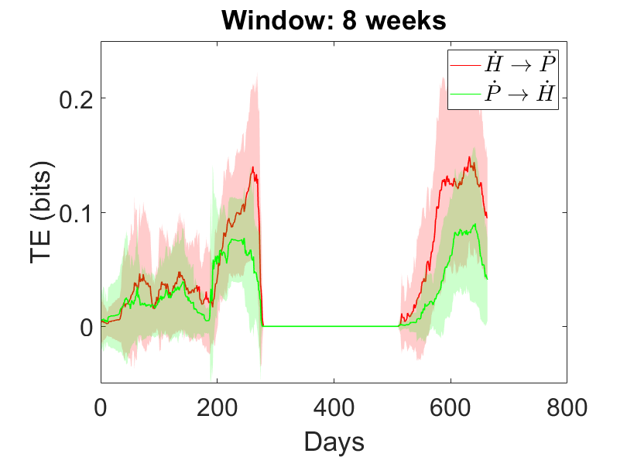
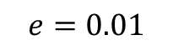
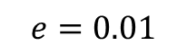
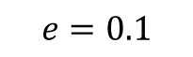
LV TE Normalized by Square root of entropies
$$e=0.01$$
$$e=0.01$$
$$e=0.1$$

Slide 7
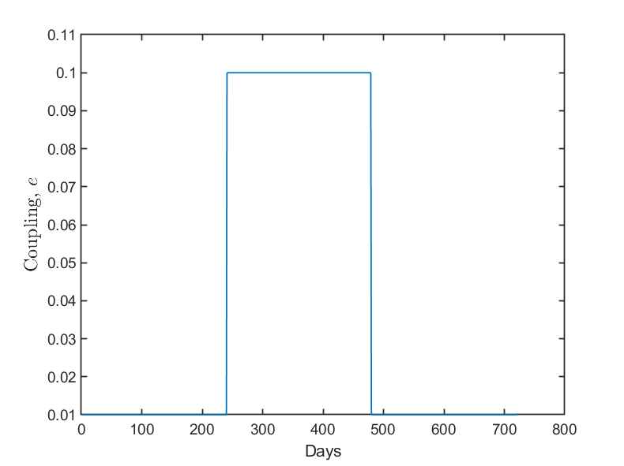
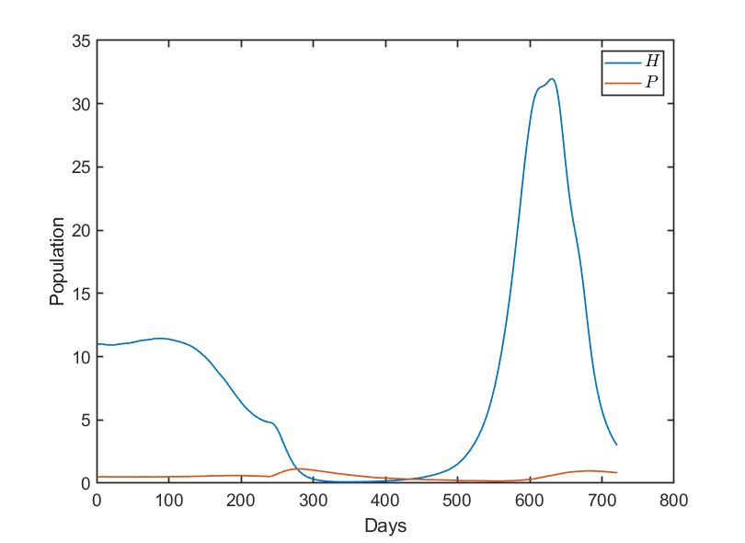
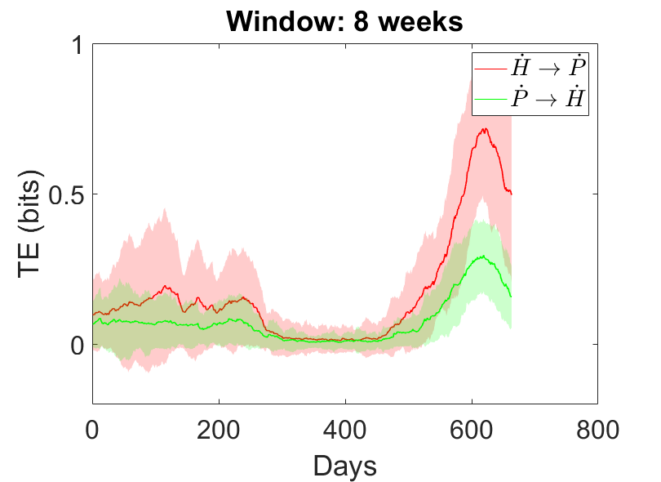
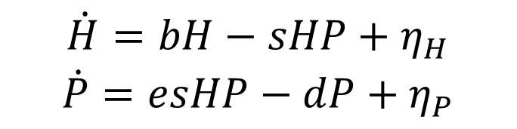
Switching Coupling parameter in Lotka Volterra
$$\dot{H}=bH−sHP+η_{H}$$
$$\dot{P}=esHP−dP+η_{P}$$

Slide 8
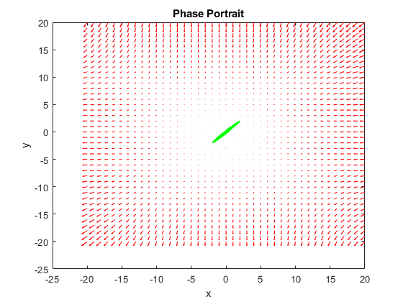
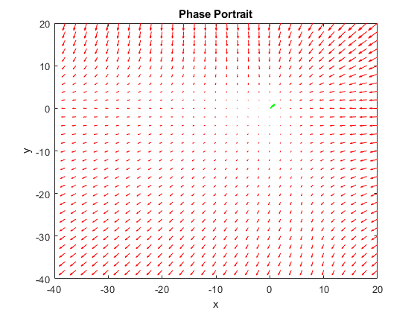
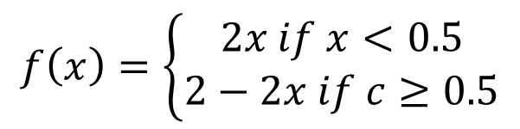
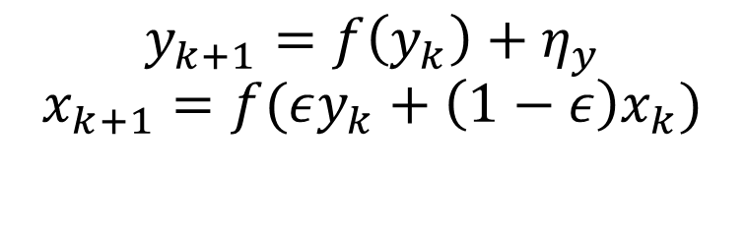
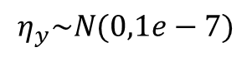
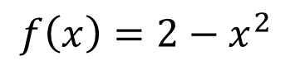
Unidirectional coupling (Tent and Ulam)
$$y_{k+1}=f\left(y_{k}\right)+η_{y}$$
$$x_{k+1}=f(εy_{k}+\left(1−ε\right)x_{k})$$
$$η_{y}\sim N(0,1e−7)$$
Tent Map
$$f\left(x\right)=\left\{\begin{aligned}2x if x<0.5 \\ 2−2x if c≥0.5\end{aligned}\right.$$
Ulam Map Phase Portrait
Tent Map Phase Portrait
Ulam Map
$$f\left(x\right)=2−x^{2}$$

Slide 9
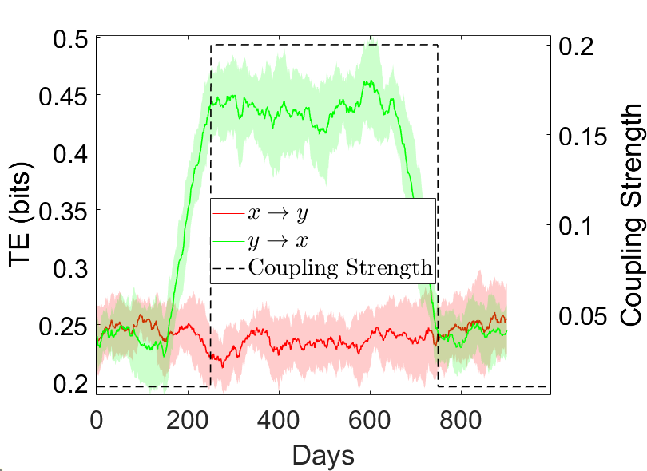
TE Tent map normalized square root of entropies and switching coupling parameter

Slide 10
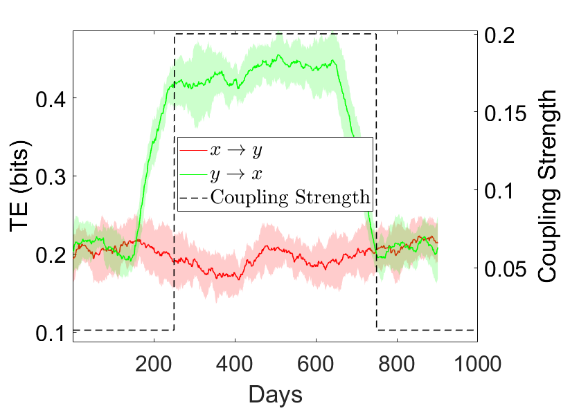
TE Ulam map normalized square root of entropies and switching coupling parameter

Slide 11
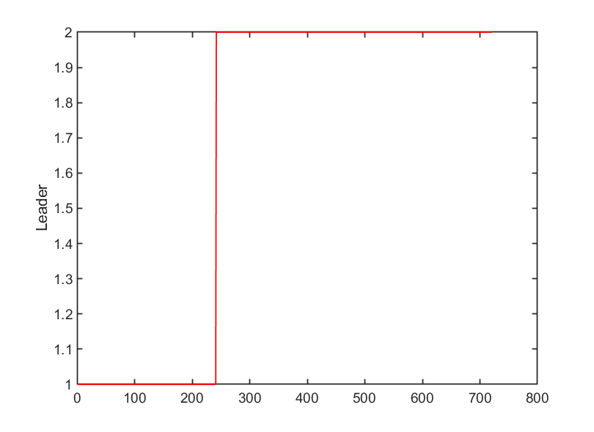
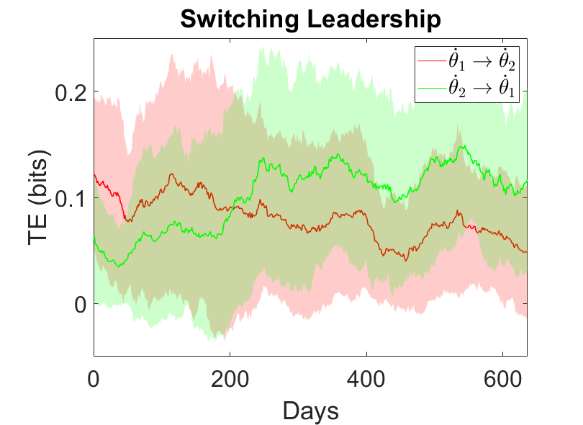
Vicsek Two Particle model with switching

Slide 12
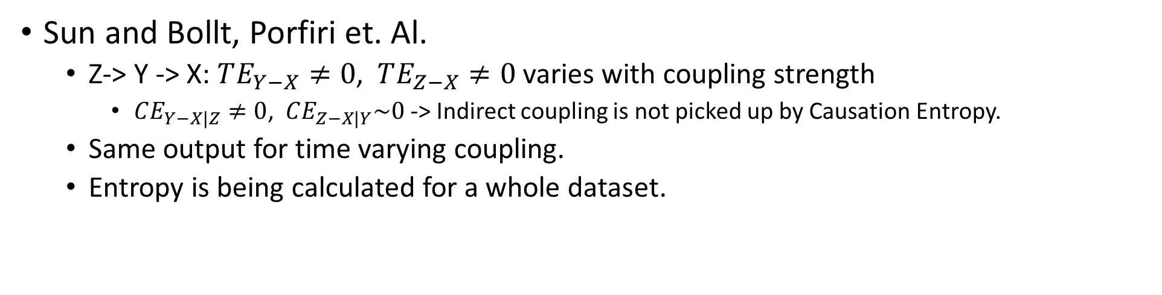
Causation Entropy/ Conditional TE
For multiple random processes, some are indirectly coupled and others are directly coupled. Transfer Entropy does not to discriminate between these direct and indirect couplings. Conditional Transfer Entropy however avoids picking up the indirectly coupled processes. For multi-way coupled models like SEIS, it is useful to obtain conditional TE to identify the processes that are directly coupled.
Sun and Bollt, Porfiri et. Al.
Z-> Y -> X: $TE_{Y−X}≠0$, $TE_{Z−X}≠0$ varies with coupling strength
$CE_{Y−X|Z}≠0$, $CE_{Z−X|Y}\sim 0$ -> Indirect coupling is not picked up by Causation Entropy.
Same output for time varying coupling.
Entropy is being calculated for a whole dataset.
J. Sun and E. M. Bollt, “Causation Entropy Identifies Indirect Influences, Dominance of Neighbors and Anticipatory Couplings,” Physica D: Nonlinear Phenomena, vol. 267, pp. 49–57, Jan. 2014, doi: 10.1016/j.physd.2013.07.001.
M. Porfiri, R. R. Sattanapalle, S. Nakayama, J. Macinko, and R. Sipahi, “Media coverage and firearm acquisition in the aftermath of a mass shooting,” Nat Hum Behav, vol. 3, no. 9, pp. 913–921, Sep. 2019, doi: 10.1038/s41562-019-0636-0.

Slide 13
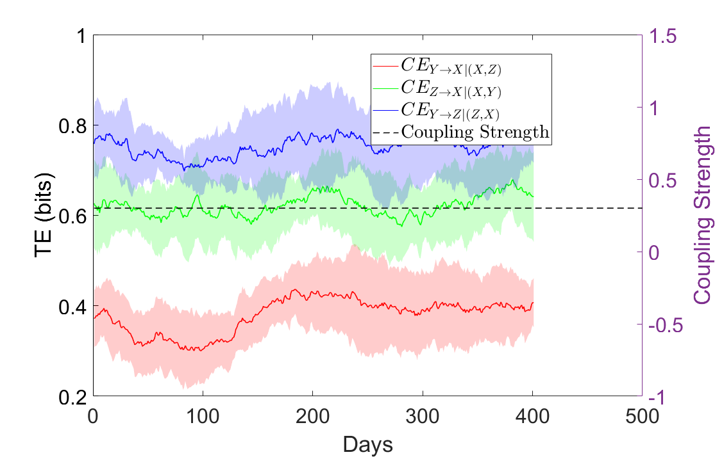
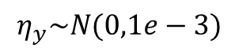
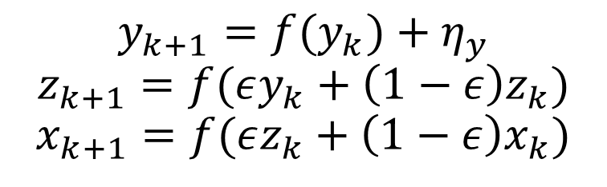
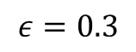
Causation Entropy Tent map
$$y_{k+1}=f(y_{k})+η_{y}$$
$$z_{k+1}=f(εy_{k}+\left(1−ε\right)z_{k})$$
$$x_{k+1}=f(εz_{k}+\left(1−ε\right)x_{k})$$
$$η_{y}\sim N(0,1e−3)$$
$$ε=0.3$$
Y -> Z -> X

Slide 14
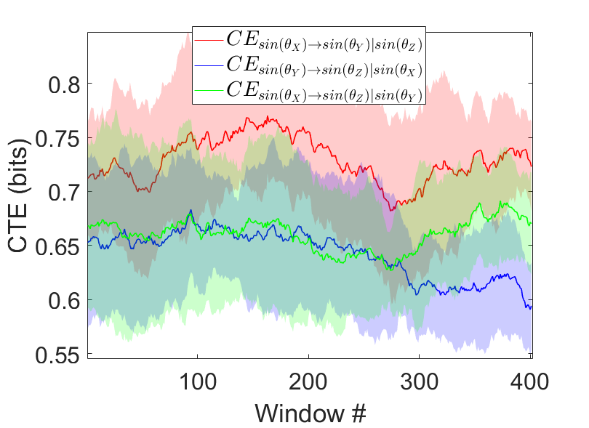
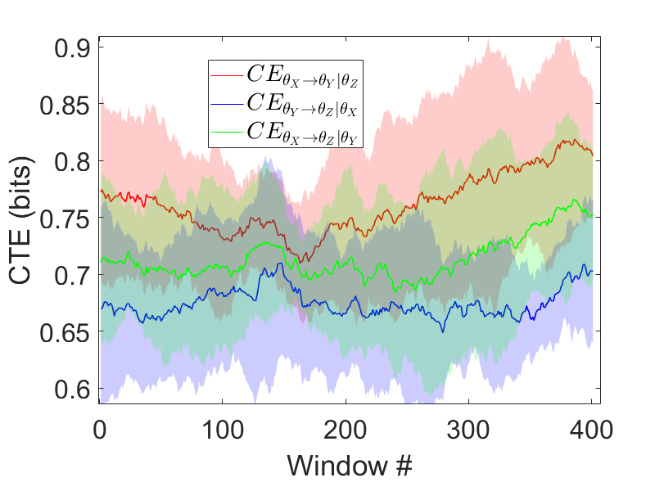
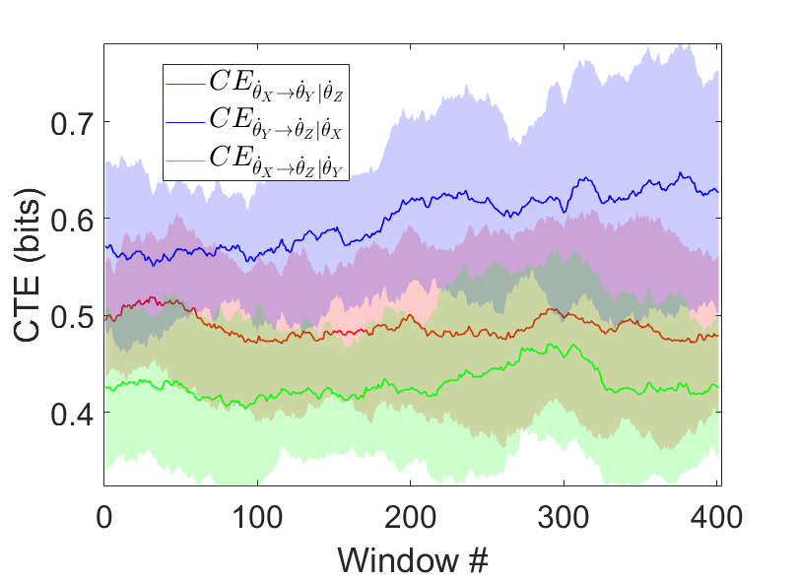
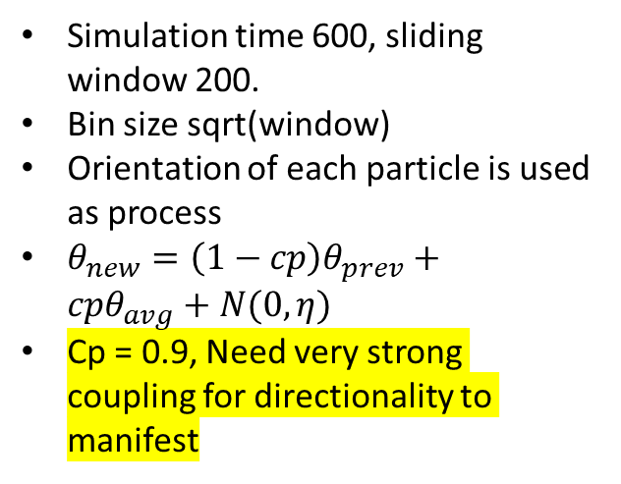
Vicsek’s Model with agent hierarchy
Three particles: X, Y, Z
X is independent.
X->Y->Z
Simulation time 600, sliding window 200.
Bin size sqrt(window)
Orientation of each particle is used as process
$θ_{new}=\left(1−cp\right)θ_{prev}+cpθ_{avg}+N(0,η)$
Cp = 0.9, Need very strong coupling for directionality to manifest

Slide 15
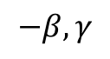
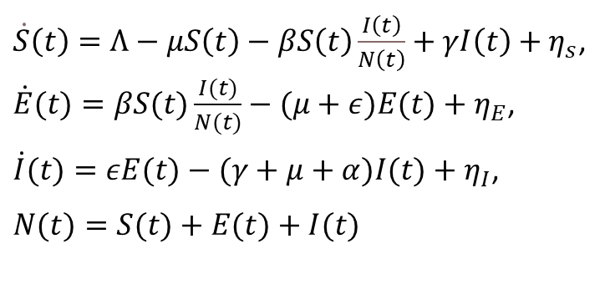
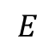
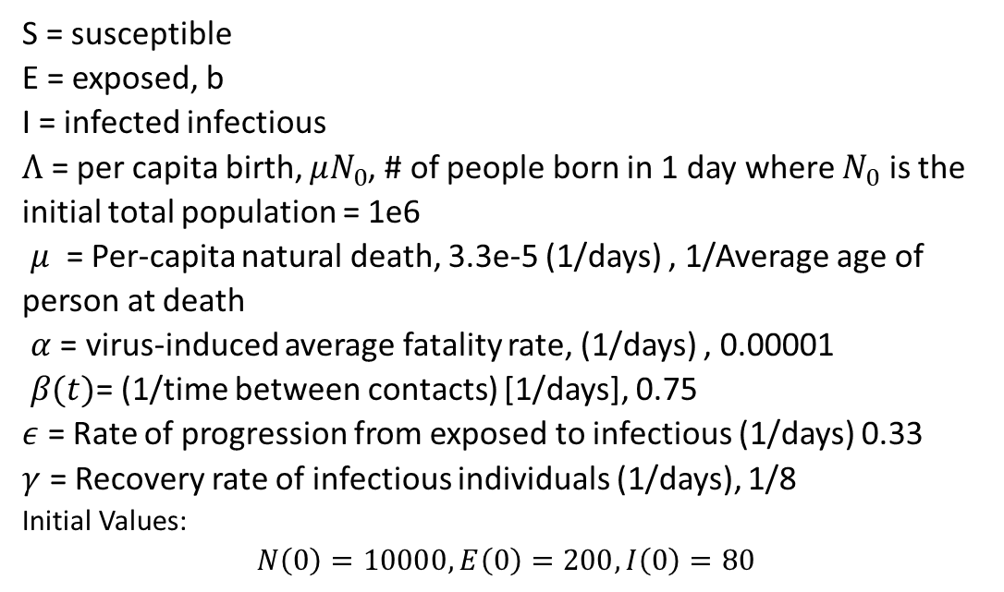
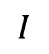
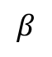
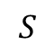
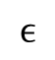
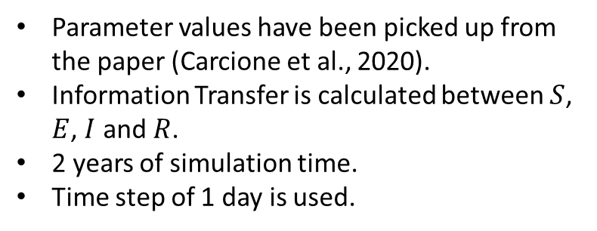
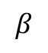
SEIS Model
$$−β,γ$$
$$S$$
$\dot{S}\left(t\right)=Λ−μS\left(t\right)−βS\left(t\right)\frac{I\left(t\right)}{N\left(t\right)}+γI\left(t\right)+η_{s}$, $\dot{E}(t)=βS(t)\frac{I(t)}{N(t)}−(μ+ε)E(t)+η_{E}$,
$\dot{I}(t)=εE(t)−(γ+μ+α)I(t)+η_{I}$,
$$N(t)=S(t)+E(t)+I(t)$$
$$I$$
$$β$$
$$ϵ$$
S = susceptible
E = exposed, b
I = infected infectious
$Λ$ = per capita birth, $μN_{0}$, # of people born in 1 day where $N_{0}$ is the initial total population = 1e6
$μ$ = Per-capita natural death, 3.3e-5 (1/days) , 1/Average age of person at death
$α$ = virus-induced average fatality rate, (1/days) , 0.00001
$β(t)$= (1/time between contacts) [1/days], 0.75
$ε$ = Rate of progression from exposed to infectious (1/days) 0.33
$γ$ = Recovery rate of infectious individuals (1/days), 1/8
Initial Values: $$N\left(0\right)=10000, E\left(0\right)=200,I\left(0\right)=80$$
$$β$$
$$E$$
Parameter values have been picked up from the paper (Carcione et al., 2020).
Information Transfer is calculated between $S$, $E$, $I$ and $R$.
2 years of simulation time.
Time step of 1 day is used.

Slide 16
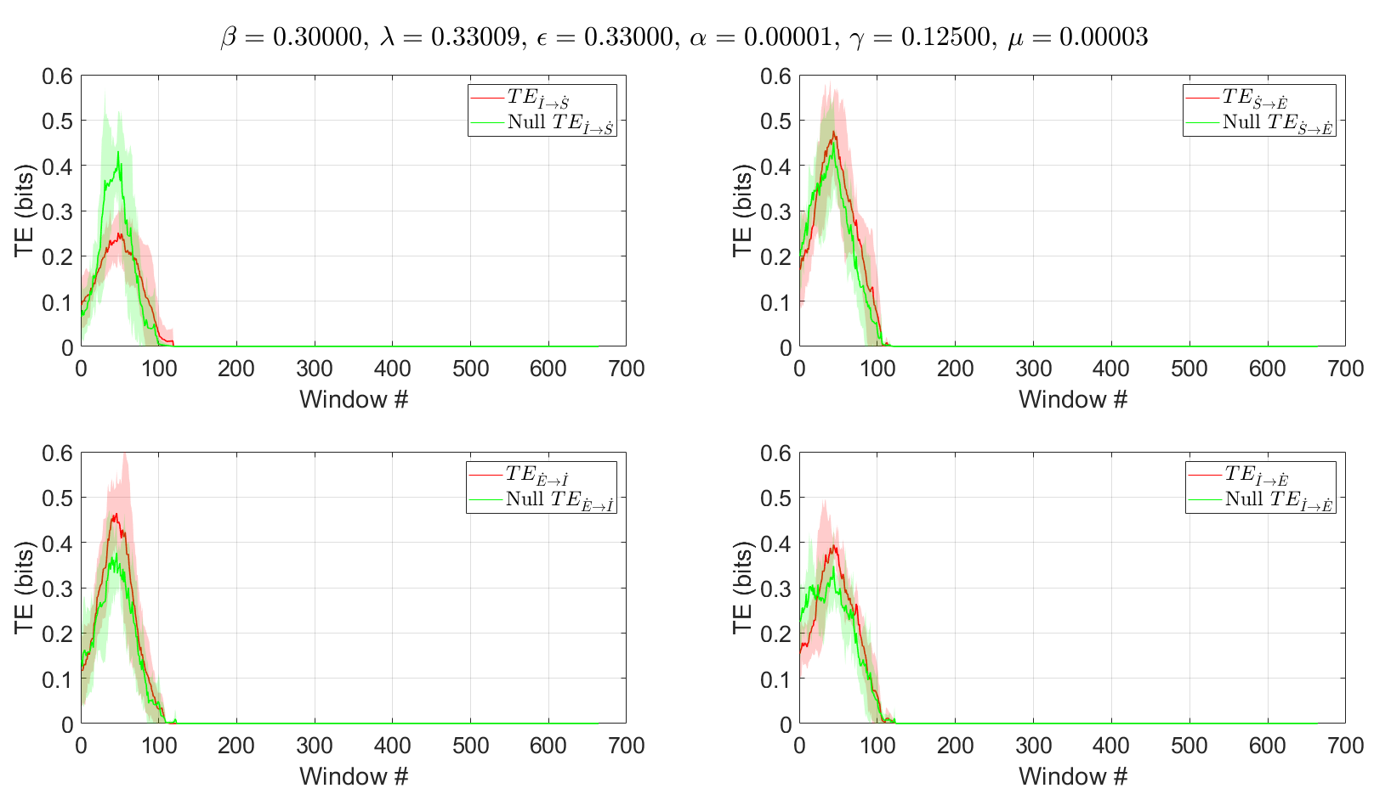







TE
Simulation time 2 year, sliding window 8 weeks.
Bin size sqrt(window)
Process used is rate of change in S,E,I
Time shifted surrogate data.
$$−\frac{βS}{N}+γ$$
$$S$$
$$I$$
$$\frac{βI}{N}$$
$$ϵ$$
$$E$$
$$\frac{βS}{N}$$

Slide 17



TE and CTE comparison
Simulation time 2 year, sliding window 8 weeks.
Bin size sqrt(window)
Process used is rate of change in S,E,I
Time shifted surrogate data
CTE is lower than its TE counterpart.

Slide 18








Updated SEIS Model
$$V$$
$${−ρ}_{v}$$
$$−β,γ$$
$$S$$
$$ρ_{m}$$
$\dot{S}\left(t\right)=Λ−μS\left(t\right)−βS\left(t\right)\frac{I\left(t\right)}{N\left(t\right)}+γI\left(t\right)+p_{m}M\left(t\right)S−p_{v}V\left(t\right)S+η_{s}$, $\dot{E}\left(t\right)=βS\left(t\right)\frac{I\left(t\right)}{N\left(t\right)}−\left(μ+ε\right)E\left(t\right)−p_{k}K\left(t\right)E+η_{E}$,
$\dot{I}(t)=εE(t)−(γ+μ+α)I(t)+η_{I}$,
$$N(t)=S(t)+E(t)+I(t)$$
$$β$$
$$M$$
$$I$$
$$ϵ$$
S = susceptible
E = exposed, b
I = infected infectious
$Λ_{n}$= per capita birth, $μN_{0}$, # of people born in 1 day where $N_{0}$ is the initial total population = 1e6
$μ$ = Per-capita natural death, 3.3e-5 (1/days) , 1/Average age of person at death
$α$ = virus-induced average fatality rate, (1/days) , 0.00001
$β(t)$= (1/time between contacts) [1/days], 0.75
$ε$ = Rate of progression from exposed to infectious (1/days) 0.33
$γ$ = Recovery rate of infectious individuals (1/days), 1/8
M(t) = Mobility
V(t) = Vaccine effectiveness
K(t) = Mask Use
Initial Values: $$N\left(0\right)=10000, E\left(0\right)=200,I\left(0\right)=80$$
$$β$$
$$E$$
$${−ρ}_{k}$$
$$K$$
Parameter values have been picked up from the paper (Carcione et al., 2020).
Information Transfer is calculated between $S$, $E$, $I$ and $R$.
2 years of simulation time.
Time step of 1 day is used.

Slide 19















Updated SEIS Model
$\dot{S}\left(t\right)=Λ−μS\left(t\right)−\frac{β\left(S\left(t\right)−ρ_{o}O\left(t\right)−ρ_{v}V\left(t\right)\right)\left(I\left(t\right)−ρ_{k}K\left(t\right)\right)}{N\left(t\right)}+γI(t)+η_{s}$, $\dot{E}\left(t\right)=\frac{β\left(S\left(t\right)−ρ_{o}O\left(t\right)−ρ_{v}V\left(t\right)\right)\left(I\left(t\right)−ρ_{k}K\left(t\right)\right)}{N\left(t\right)}−\left(μ+ε\right)E\left(t\right)+η_{E}$,
$\dot{I}(t)=εE(t)−(γ+μ+α)I(t)+η_{I}$,
$$N\left(t\right)=S\left(t\right)+E\left(t\right)+I\left(t\right)+O\left(t\right)+V\left(t\right)+K(t)$$
$$V$$
$${−ρ}_{v}$$
$$−\frac{βS}{N}+γ$$
$$S$$
$$ρ_{m}$$
$$\frac{βI}{N}$$
$$M$$
$$I$$
$$ϵ$$
$$E$$
$${−ρ}_{k}$$
S = susceptible
E = exposed, b
I = infected infectious
$Λ$ = per capita birth, $μN_{0}$, # of people born in 1 day where $N_{0}$ is the initial total population = 1e6
$μ$ = Per-capita natural death, 3.3e-5 (1/days) , 1/Average age of person at death
$α$ = virus-induced average fatality rate, (1/days) , 0.00001
$β(t)$= (1/time between contacts) [1/days], 0.75
$ε$ = Rate of progression from exposed to infectious (1/days) 0.33
$γ$ = Recovery rate of infectious individuals (1/days), 1/8
O(t) = # Isolated
V(t) = # vaccinated
K(t) = Mask Use
Initial Values: $N\left(0\right)=10000, E\left(0\right)=200,I\left(0\right)=80$
$$\frac{βS}{N}$$
$$K$$

Slide 20











Updated SEIS Model
$$\dot{S}=λN−μS −\frac{β_{I}SI}{N}−\frac{β_{k}SK}{N}−\frac{β_{o}SO}{N}+γ_{I}I+γ_{k}K+γ_{o}O−ρ_{L}S+ρ_{R}L$$
$\dot{E}=\frac{β_{I}SI}{N}+\frac{β_{k}SK}{N}+\frac{β_{o}SO}{N}−εE−μE$
$$\dot{I}=εE−γ_{I}I−μI−αI−ρ_{k}I−ρ_{o}O$$
$$\dot{K}=ρ_{k}I−γ_{k}K$$
$$\dot{L}=ρ_{L}S−ρ_{R}L$$
$\dot{O}=ρ_{0}O−γ_{O}O$
S: Susceptible who are not isolated and not vaccinated $S_{0}$
L: Locked down, $S_{h}$
V: vaccinated
I: Infected + not wearing masks
K : Infected + wearing masks
O : Isolated
$ρ_{L}$= rate of lockdown
$ρ_{R}$ = rate of reopening
$ρ_{k}$= Mask acceptance
$ρ_{o}$ = isolation prev
$γ_{k}$= Recovery rate for infected individuals (Infected + wearing masks)
$γ_{I}$= Recovery rate (Infected + not wearing masks)
$γ_{O}=$ Conversion rate of isolated to susceptible
$$γ_{k}$$
$$ε$$
S
$$\frac{β_{I}I}{N}+\frac{β_{k}K}{N}+\frac{β_{o}O}{N}$$
E
I
$$ρ_{R}$$
$$ρ_{L}$$
$$ρ_{k}− γ_{k}$$
X
L
X
K
$$γ_{O}$$
V
$$γ_{k}$$
$$γ_{O}$$
O

Slide 21




Slide 22











TE and CTE
Expecting to see TE < CTE
Expecting to see TE < CTE
Expecting to see K->E higher than S->E
$$V$$
$$−β,γ$$
$$S$$
$$β$$
$$M$$
$$I$$
$$ϵ$$
$$β$$
$$E$$
$$K$$

Slide 23


Methods
Why not use mask, vaccination, mobility, infection and mortality data directly to compute TE or CTE?
TE will only identify causal links b/w the data
It doesn’t tell us the mechanism
It represents only one experiment, but TE needs more data.
TE b/w Mask, Vaccinated, Mobility to Infected on real data will indicate relative link strengths.
An existing SEIR* model will be modified to include mask, vaccination and isolation compartments. It will be fitted to the real data, that will enable extraction of hidden variables like S, E, and R.
The mechanics of infection can be identified by using conditional TE (CTE):
Most effective paths leading to infection can be found by comparing CTEs of different paths.
Looking at $S_{m} →I$, the figure notes 2 paths b/w the start and end points. $TE_{S_{m}→I}$ will tell us the causality b/w the two parameters. $CTE_{S_{m}→I|E_{m}}$ will tell us the influence $S_{m}$ will have on $I$ disregarding influence of $E_{m} →I$, thus if $CTE_{S_{m}→I|E_{m}}<CTE_{S_{m}→I|S}$ which would mean the blue line carries less influence than red line.
*Maged, Ahmed, et al. "SEIR Model to address the impact of face masks amid COVID‐19 pandemic." Risk Analysis (2022).

Slide 24

Raw smoothed Data (USA) using healthdata model

Slide 25

SEIR model with vaccination*
*Maged, Ahmed, et al. "SEIR Model to address the impact of face masks amid COVID‐19 pandemic." Risk Analysis (2022).

Slide 26

Author results

Slide 27

Reproduced results

Slide 28

Table of parameters
Parameters
$η_{s}$= Decrease in susceptibility b/c of mask, 0.35 | $β$ = Transmissibility, 0.312 | $I$ = not masked, infectious
$η_{i}$= Decrease in infectivity b/c of mask, 0.45 | $α$ = Vaccination rate, 0.001 | $I_{m}$ = masked, infectious
$σ$ = vaccine inefficiency, 0.001 | $λ$ = Conversion rate from $S →E$ | $V$ = Vaccinated
$ε$ = progression to Infectious class, 0.22 | $λ_{m}$ = Conversion rate from $S_{m}→E_{m}$ | $R$ = Recovered
$ω$ = ratio of vaccinated individuals wearing masks, 0.005 | $S$ = not masked, susceptible | $D$ = Dead
$γ$= Recovery rate, 0.0602 | $S_{m}$ = masked, susceptible | $φ_{X}$= Conversion rate from masked to not masked within a class
$μ$ = Mortality, 0.0035 | $E$ = not masked, exposed | $φ_{Xm}$ = Conversion rate from not masked to masked within a class
$τ$ = threshold after which people start wearing masks, 100 | $E_{m}$= masked, exposed | $ω_{R}$ = rate of recovered to susceptible population wearing masks b/c of new virus strains
 |  | $κ$ = rate of conversion of recovered population to susceptible class

Slide 29






SEIR model with vaccination, with proposed new transmission dynamics
$$κ_{Rm}R$$
X
$$αS_{m}$$
Recovered population can become susceptible due to new strains and waning immunity
Vaccinated population renamed to M (currently immune)
M can become susceptible (not exposed) due to waning immunity
Add isolated compartments for S, E and I
$$σ_{Vm}V$$
M
$$σ_{V}V$$
$$αS$$
X
$$κ_{R}R$$

Slide 30





























New Model
$$κ_{r_{M}}R$$
$$S_{m}$$
$$λ_{m}S_{m}$$
$$E_{m}$$
$$εE_{m}$$
$$I_{m}$$
$$σ_{S_{m}}V$$
$$μI_{m}$$
$$D$$
$$αS_{m}$$
$$γI_{m}$$
$$M$$
$$φ_{S_{m}}S$$
$$φ_{S}S_{m}$$
$$φ_{E_{m}}E$$
$$φ_{E}E_{m}$$
$$φ_{I_{m}}I$$
$$φ_{I}I_{m}$$
$$αS$$
$$R$$
$$μI$$
$$S$$
$$E$$
$$I$$
$$σ_{S}V$$
$$γI$$
$$λS$$
$$εE$$
$$κ_{R}R$$

Slide 31


TE application to Real Data*
1000 days of data, all of USA.
Transfer Entropy is calculated over 8 week sliding window.
Bin size used for entropy calculation is $ceil(\sqrt{window length}$)
The data was de-trended before TE calculation
$$TE_{X→Y}=H\left(X_{t} | X_{t−1}\right)−H(X_{t}|X_{t−1},Y_{t−1})$$
$TE_{X→Y} −$Transfer entropy from process X to Y
$H−$ Entropy
Gathered Data
$M$= Daily mask use as reported as percentage of population
$Mob$ = Cell phone mobility data as change w.r.t. background levels
$I$= Number of people we estimate are infected with COVID-19
each day, including those not tested
$Vax$= Total vaccinated people
Null Model
Null model of the focal process is created by shifting the time series by 21 days
Transfer Entropy Sliding Window
*https://covid19.healthdata.org/united-states-of-america?view=social-distancing&tab=trend

Slide 32

Plot of raw data differentiated with time

Slide 33

Stationarity Test

Slide 34


TE
Transfer Entropies are calculated on rates of mask use, infectious, vaccinated and mobility
To fit the model:
The sum of compartments containing masked($S_{m}, E_{m},{ I}_{m}$) individuals normalized by population of US will be fit to mask use data.
The sum of Infected individuals ($I_{m}, I$) will be fit to daily infection data.
The number of deaths ($D$) will be fit to total death recorded.
The cumulative vaccinated from model will be fit to the total vaccinated numbers.

Slide 35
Next Steps
Add mobility, mask use, vaccination rate, waning immunity to the SEIS model.
Use real data: Johns Hopkins, healthdata.org and SafeGraph(mobility)
Use symbolic Transfer Entropy?
Vaccination affects mobility which affect susceptible population.
Put a question before every plot. Ex-> Does TE pick direct causal connection, (ii) can CTE remove the effect of Y from X->Y->Z
Change the time-shift in surrogate data

Slide 36
References
Carcione, J. M., Santos, J. E., Bagaini, C., & Ba, J. (2020). A simulation of a COVID-19 epidemic based on a deterministic SEIR model. Frontiers in Public Health.
Sugihara, G., May, R., Ye, H., Hsieh, C.-hao, Deyle, E., Fogarty, M., & Munch, S. (2012). Detecting causality in complex ecosystems. Science, 338(6106), 496–500.
Tkachenko, A. V., Maslov, S., Wang, T., Elbana, A., Wong, G. N., & Goldenfeld, N. (2021). Stochastic social behavior coupled to COVID-19 dynamics leads to waves, plateaus, and an endemic state. ELife, 10.
Yang, A. C., Peng, C.-K., & Huang, N. E. (2018). Causal decomposition in the mutual causation system. Nature Communications, 9(1).

Slide 37






SEIS TE, varying $β$
$$β$$

Slide 38

SEIS Model
$\dot{S}\left(t\right)=Λ−μS\left(t\right)−βS\left(t\right)\frac{I\left(t\right)}{N\left(t\right)}+γI\left(t\right)+η_{s}$, $\dot{E}(t)=βS(t)\frac{I(t)}{N(t)}−(μ+ε)E(t)+η_{E}$,
$\dot{I}(t)=εE(t)−(γ+μ+α)I(t)+η_{I}$,
$$N(t)=S(t)+E(t)+I(t)$$
S = susceptible
E = exposed, b
I = infected infectious
$Λ$ = per capita birth, $μN_{0}$, # of people born in 1 day where $N_{0}$ is the initial total population = 1e6
$μ$ = Per-capita natural death, 3.3e-5 (1/days) , 1/Average age of person at death
$α$ = virus-induced average fatality rate, (1/days) , 0.00001
$β(t)$= $\left(\text{1+ }\text{sin}\text{(}ω_{u}t\text{)}\right))\frac{1}{2}+η_{β}$, $ω_{u}=180 days$, $η_{β}\sim N(0,0.01)$
$ε$ = Rate of progression from exposed to infectious (1/days) 0.33
$γ$ = Recovery rate of infectious individuals (1/days), 1/8
Initial Values: $$N\left(0\right)=10000, E\left(0\right)=200,I\left(0\right)=80$$
Parameter values have been picked up from the paper (Carcione et al., 2020).
Information Transfer is calculated between $S$, $E$, $I$ and $R$.
2 years of simulation time.
Time step of 1 day is used.

Slide 39



SEIS, S-I, I-E, SE
$\dot{S}\left(t\right)=Λ−μS\left(t\right)−βS\left(t\right)\frac{I\left(t\right)}{N\left(t\right)}+γI\left(t\right)+η_{s}$, $\dot{E}(t)=βS(t)\frac{I(t)}{N(t)}−(μ+ε)E(t)+η_{E}$,
$\dot{I}(t)=εE(t)−(γ+μ+α)I(t)+η_{I}$,
$$N(t)=S(t)+E(t)+I(t)$$

Slide 40



Vicsek’s Model with agent hierarchy
Subsampled (1/2)
Three particles: X, Y, Z
X is independent.
X->Y->Z
Simulation time 600, sliding window 200.
Bin size sqrt(window)
Orientation of each particle is used as process

Slide 41






Vicsek’s Model with agent hierarchy and coupling
$$ε=0.1$$
$$ε=0.5$$
Three particles: X, Y, Z
X is independent.
X->Y->Z
Simulation time 600, sliding window 200.
Bin size sqrt(window)
Orientation of each particle is used as process
$$ε=1.0$$

Slide 42





Vicsek’s Model with agent hierarchy and coupling
$$ε=0.1$$
$$ε=0.5$$
Three particles: X, Y, Z
X is independent.
X->Y->Z
Simulation time 600, sliding window 200.
Bin size sqrt(window)
Orientation of each particle is used as process
$$ε=1.0$$

Slide 43

Vicsek’s Model with agent hierarchy and coupling
Three particles: X, Y, Z
X is independent.
X->Y->Z
Simulation time 400
Bin size sqrt(400)
Orientation of each particle is used as process

Slide 44










TE of SEIS with Null model 16 weeks
-$β,γ$
$$S$$
$$I$$
$$β$$
$$ϵ$$
$$β$$
$$E$$
$$β=0.75+η(0,0.1)$$
$$γ=0.125$$
$$ε=0.33$$
Simulation time 2 year, sliding window 16 weeks.
Bin size sqrt(window)
Process used is rate of change in S,E,I
Suppressing the coupling parameters may show directionality
$β>ε>γ$

Slide 45


